Slide 1
Welcome to the last session in this Theory Course

Slide 2
Revision Plus Catch All
Anything you want to go over
Quick Honey Harvest
Other products
Mead
Wax
Candles
Creams
© BABKA

Slide 3
Practical sessions
You will be notified when these are to start, early May usually
It is Weather dependent
Location
Old Park apiary, Church Fenton (Details will be provided in your members email)
Equipment you will need
CLEAN wellies/boots
CLEAN Gloves, washing-up type or Nitrile (size)
Your own CLEAN bee suit
Tutors will enforce BBKA Good Practice Apiary Hygiene
© BABKA
Notes:
This needs to be adapted to your circumstances.

Slide 4
1st Practical Session
You will be shown how to light a smoker.
How to open a bee hive
How to take some frames out
What to look for on a frame of bees
Given the opportunity to remove a frame your self
Date of the first practical will be Thursday the 2nd of May at 6.30 p.m. until around 9.00 p.m.
© BABKA

Slide 5
Your Questions
If you do not ask – we cannot answer
Other members will be interested in your question and its answer, so don’t be shy.
We would like to know where we have failed to make things clear, so please tell us.
All answers are subject to “It depends” clause
© BABKA

Slide 6
The Honey Harvest
© BABKA

Slide 7
Is your Honey ready?
Sealed cells
Mostly sealed and unable to shake out honey
Tested with Refractometer less than 20% water
legal limit, 23% water if Heather
Better if closer to 18% water
© BABKA

Slide 8
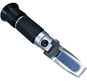
Refractometer
Now available at less than £30
Calibrated in water % in honey
© BABKA
Notes:
Have a refractometer and demonstrate it

Slide 9
Removing a full Super of Combs
Two basic Methods
Super clearing using clearing boards
Brush and Rush
© BABKA

Slide 10
Super Clearing
Use clearer board between super to be removed & rest of hive
Usually takes overnight
Principle is that bees leave the super and cannot return to it (non return valve)
Problematic for honey that crystallises like OSRape
Temperature in super drops without bees if it falls too far honey sets.
Usually ok for summer honey or heather honey.
© BABKA
Notes:
Have examples to handle of following types if possible.

Slide 11
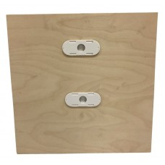
Standard crown board with escapes
© BABKA

Slide 12
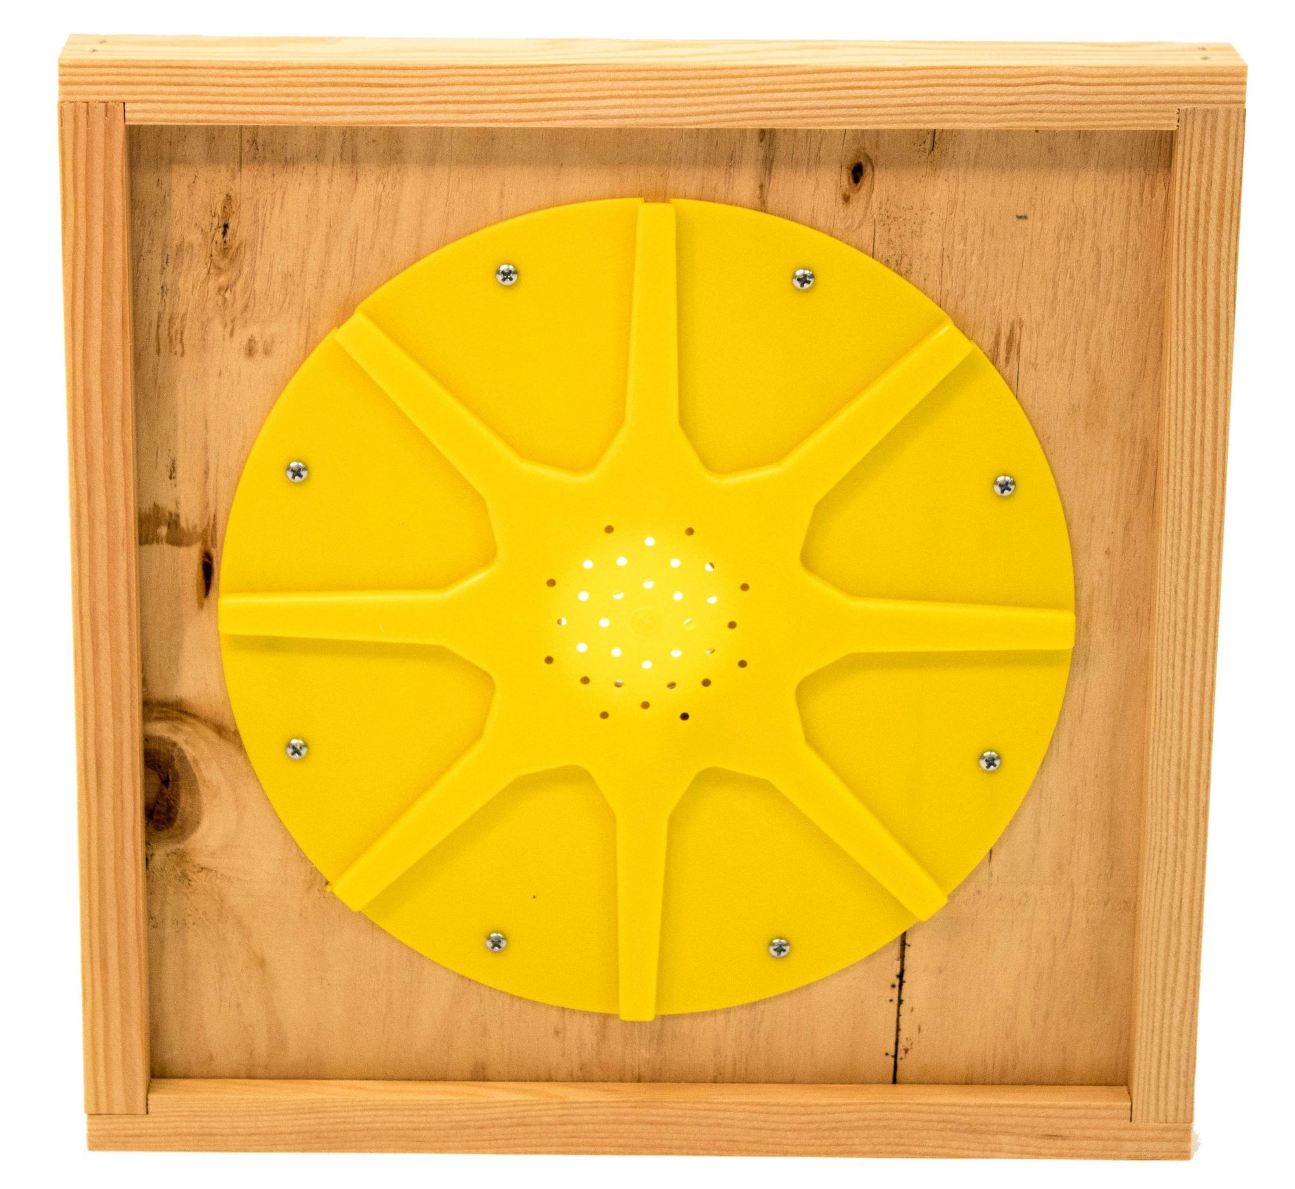
Octagonal clearing board
© BABKA

Slide 13
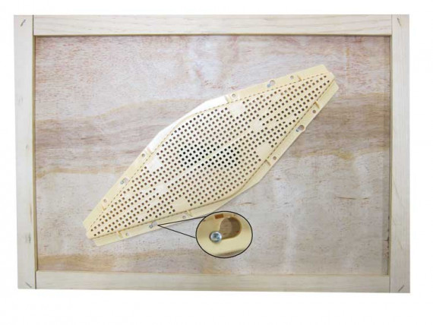
Rhomboid clearing board
© BABKA

Slide 14
Brush and Rush
Shake off bees from the frame back into the colony
Brush any remaining bees off
Put the shaken frame into another empty super with an upside down roof and bee tight lid to prevent bees from getting back on the comb
Remove to Bee tight area
They will try to get it back if you let them!
© BABKA
Notes:
Arrange some real equipment to show this

Slide 15
Extracting Liquid honey

Slide 16
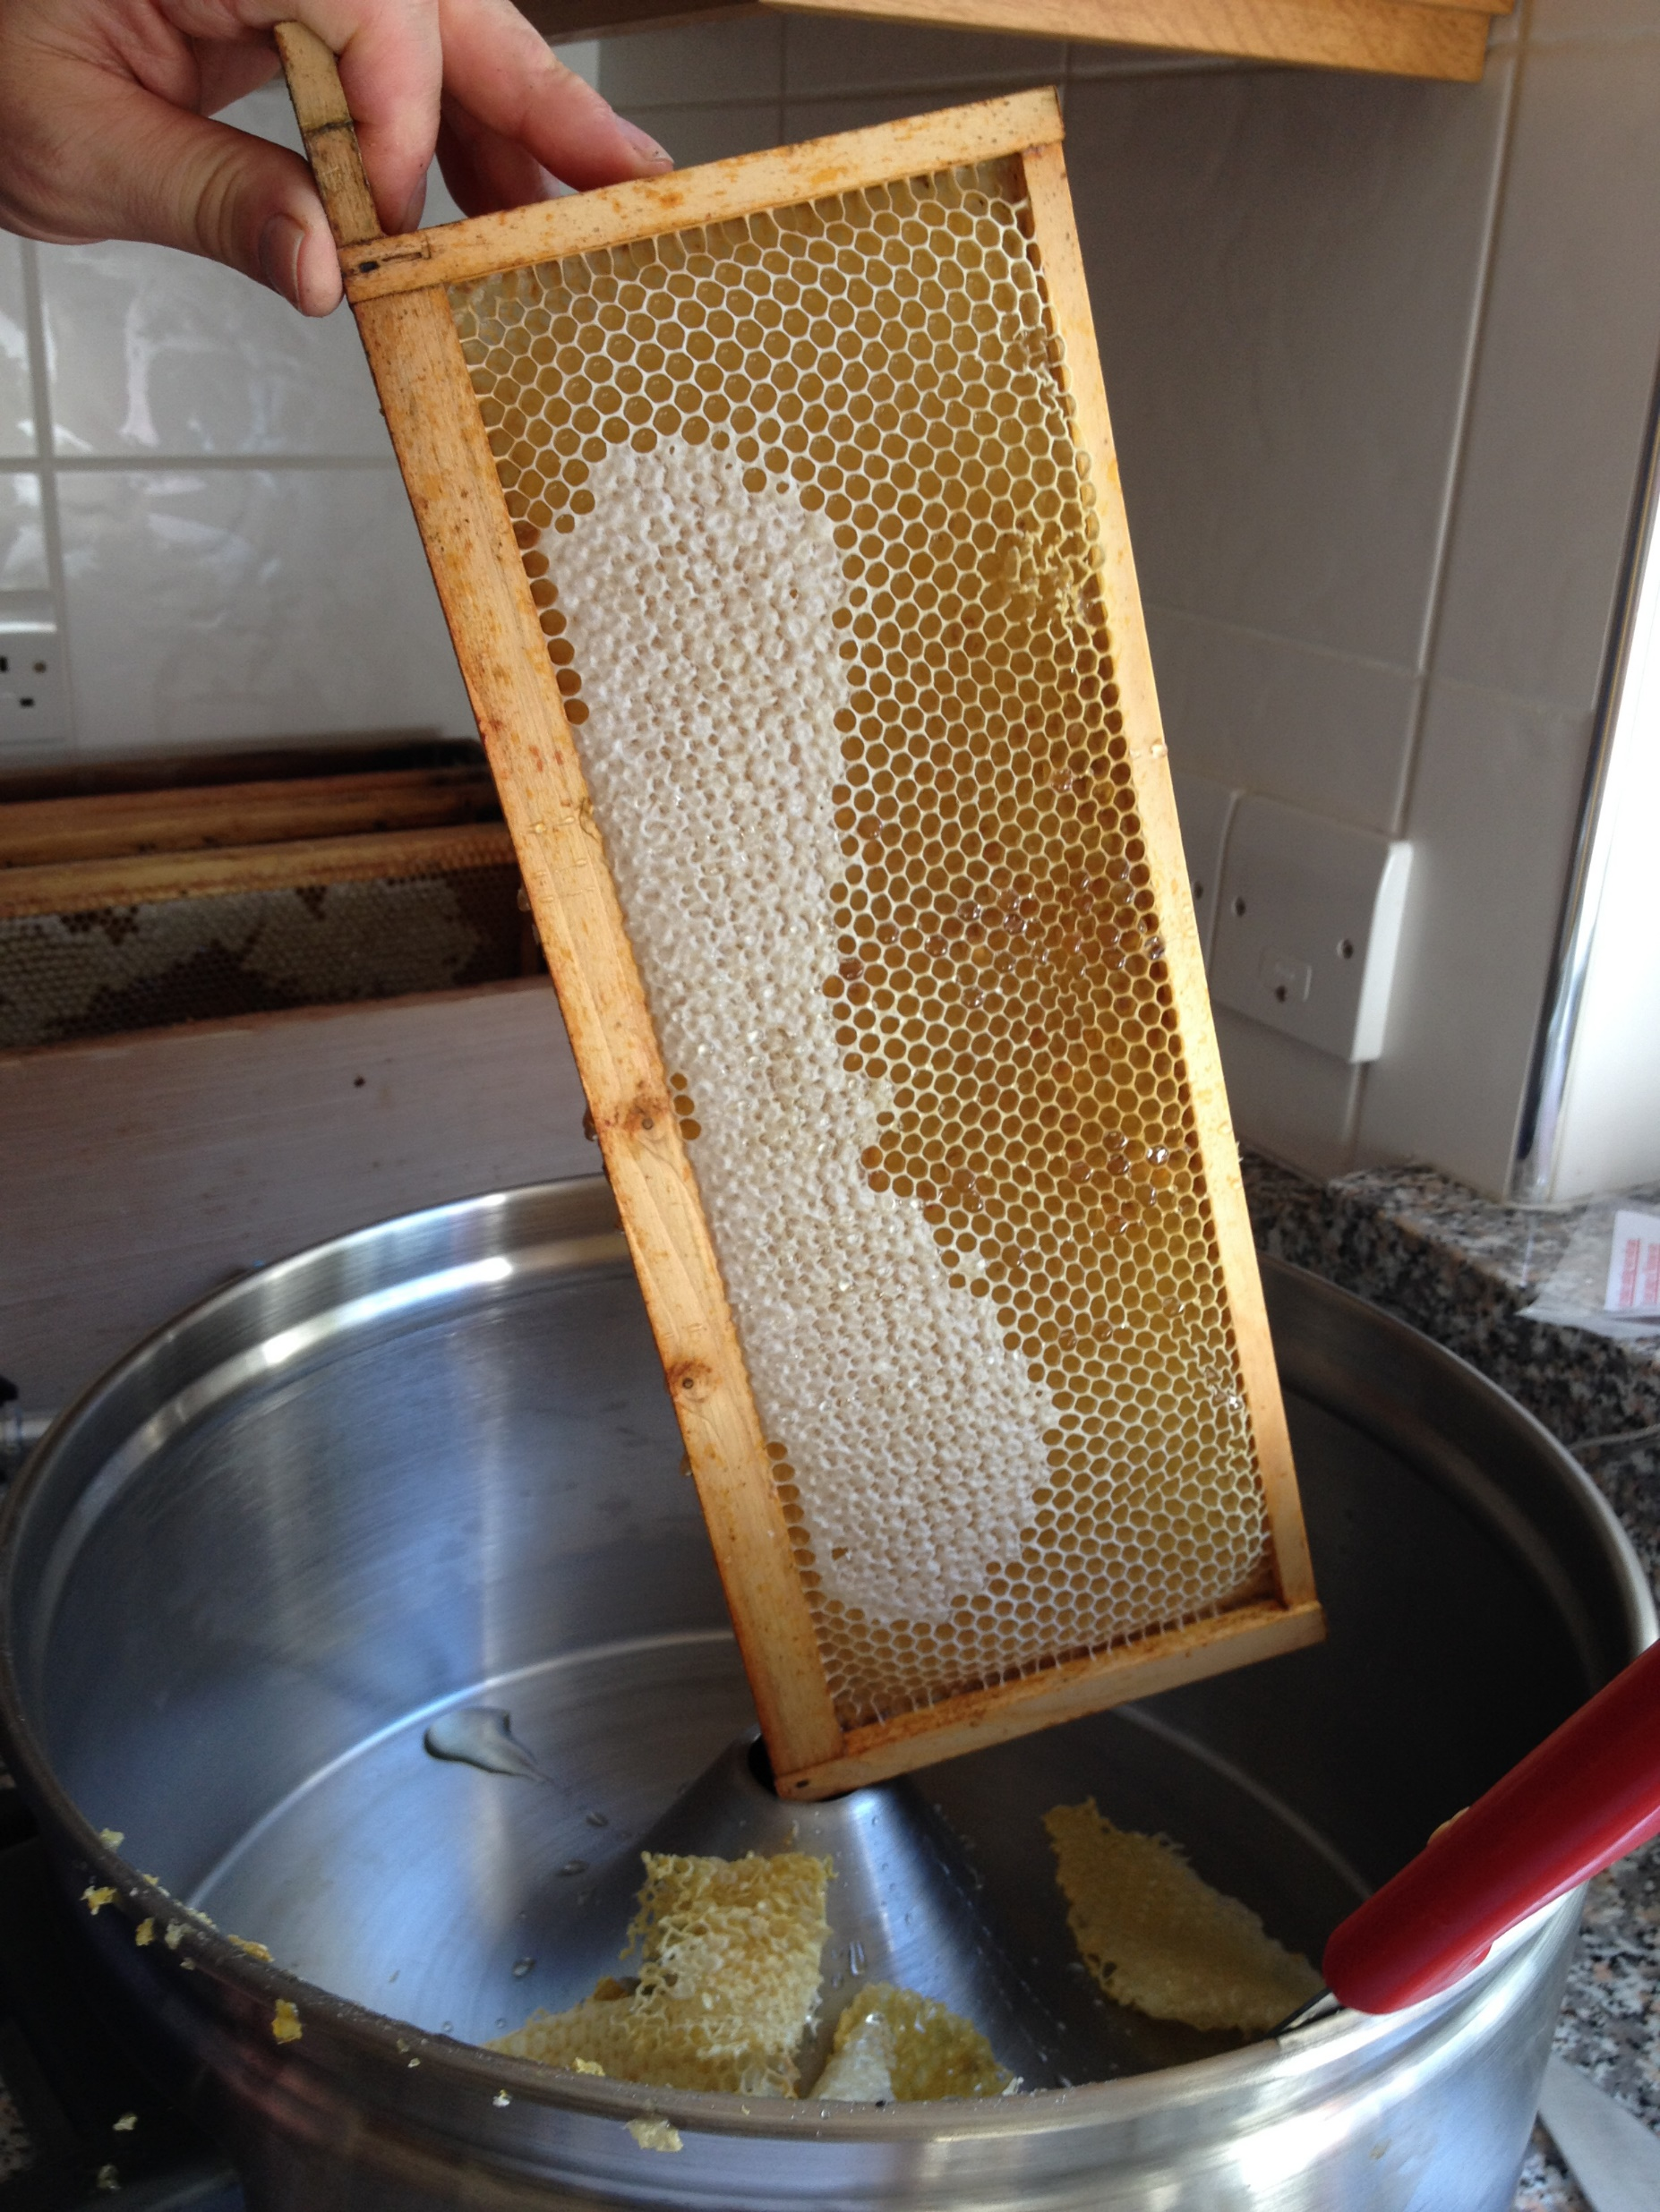
Hold frame over container slanted slightly forward.
A batten with a nail through it over a bowl works well
© BABKA

Slide 17
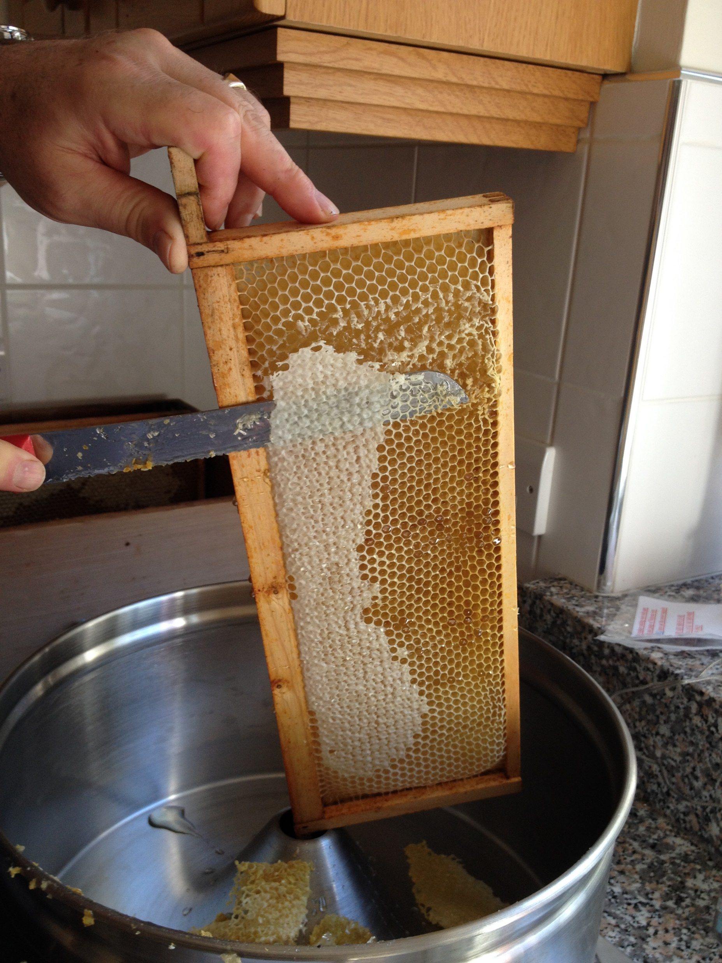
Cut downward so wax falls away from the frame
© BABKA

Slide 18
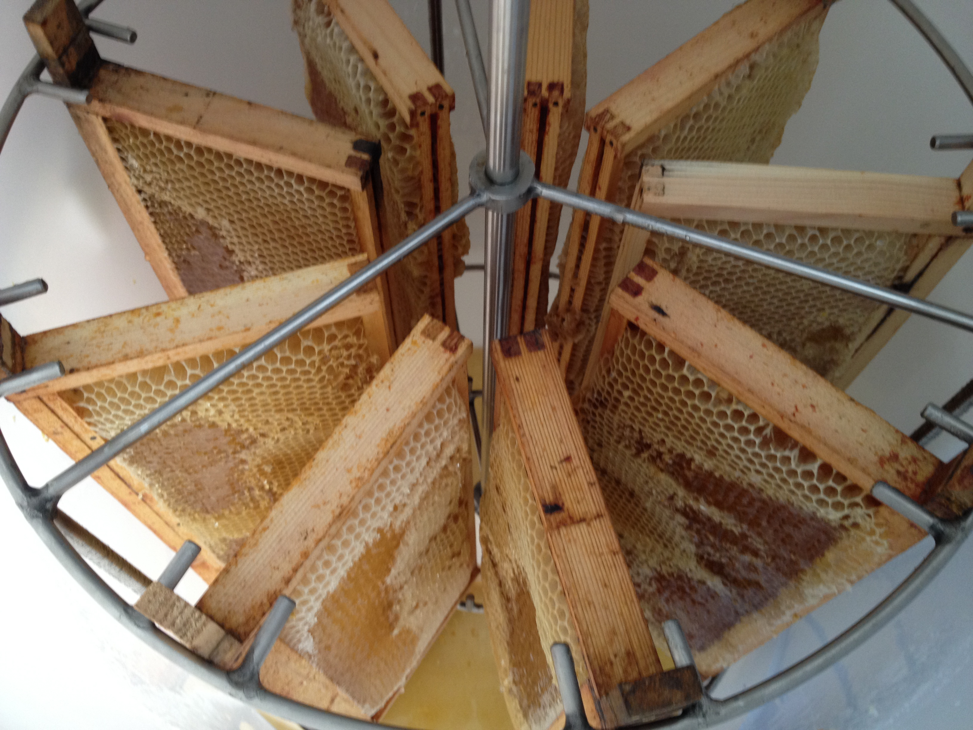
Try to balance extractor
© BABKA

Slide 19
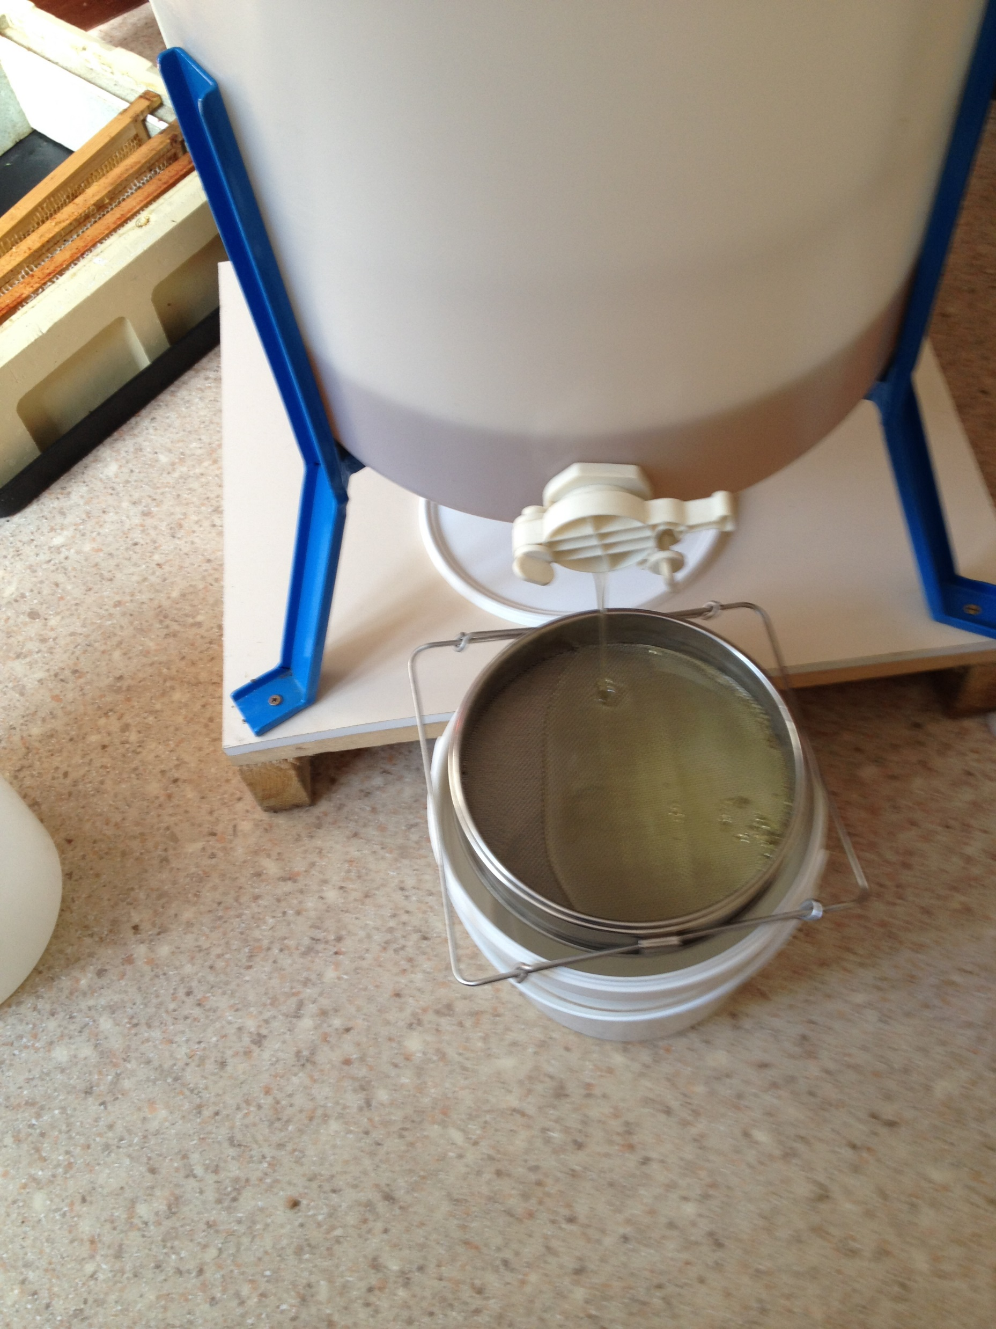
Drain honey thru 2 strainers one course
one fine
© BABKA

Slide 20
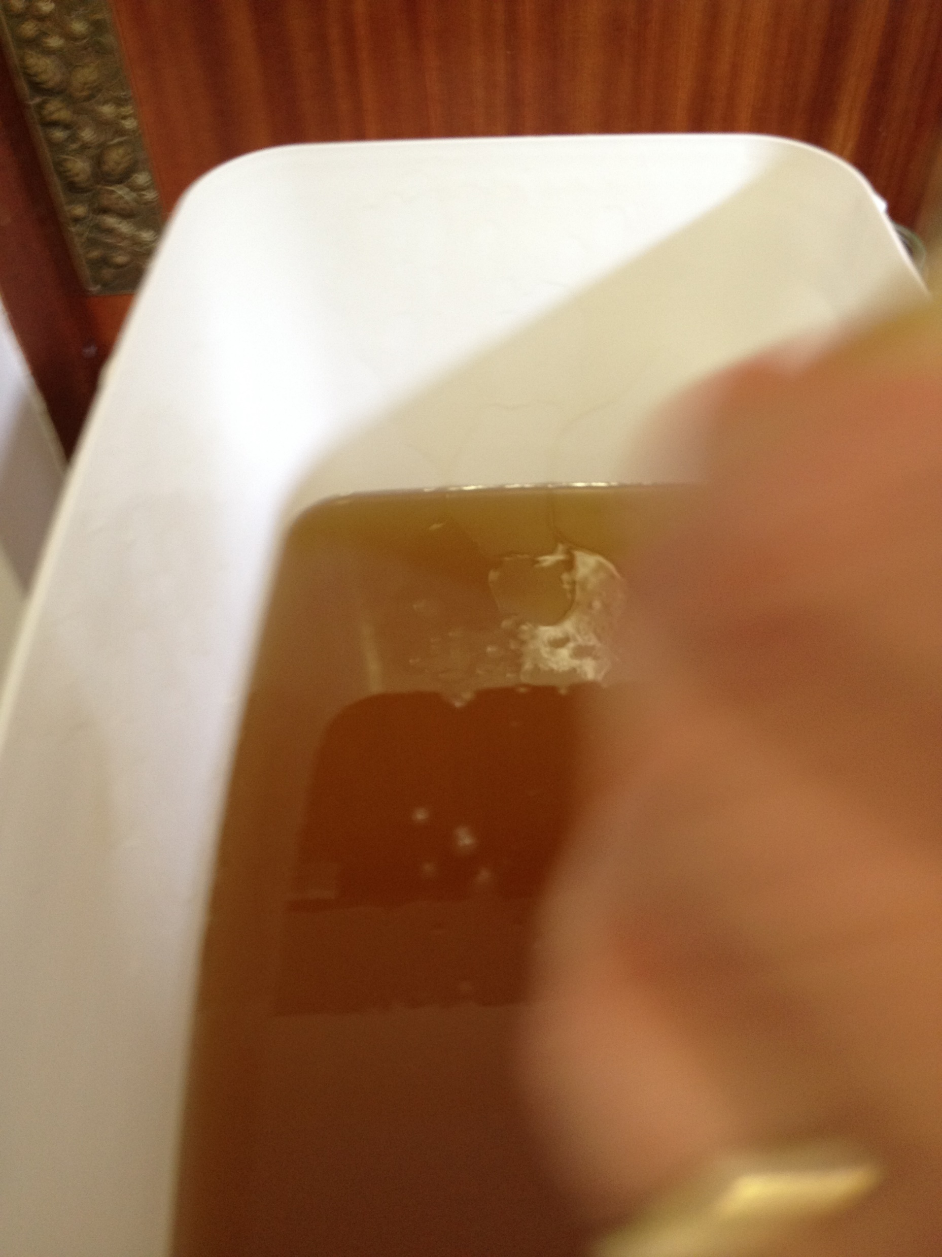
Honey settling so any pollen and small wax particles can rise to the top
© BABKA

Slide 21
Loan Equipment
The association has some equipment to borrow when you have honey to process
It is held by Tony Bowey and can be requested by email.

Slide 22
Labelling
If you buy labels they should be ok
If you print your own check size of print especially weight after printing
Not required but useful
Infant warning
Crystallization information
Security seal
© BABKA

Slide 23
Sample Label
© BABKA

Slide 24
As well as Honey?
Mead
Wax
Candles
Creams
© BABKA

Slide 25
Mead
Alcoholic drink (Honey Wine)
Cold water used for washing out wax capping’s may have enough honey for brewing
Can be brewed with fruit juice, spices etc
Good BBKA Special issue on mead available
Warning can get to 17% easily!!!!
© BABKA
Notes:
Any samples for tasting are always appreciated – use the tiny plastic tasting cups.

Slide 26
Wax
Good apiary hygiene will generate wax
From collected brace comb
From renewing old frames of comb
These are a valuable source of wax
© BABKA

Slide 27
What can I do with this wax?
Clean it a bit and trade it in
Clean it a bit better and sell it as blocks
Make candles for use or sale
© BABKA

Slide 28
WHY bother processing?
Trade in wax (Thornes prices)
Trade in for new foundation, kg £19.53
Against purchase of goods, kg £3.50
Outright purchase, kg £2.25
Process your wax
1oz (28g) of filtered wax £1.50
1kg filtered wax £53 approx
© BABKA
Notes:
This speaks for itself (2020 prices)
Well made and packaged candles are sought after and sell for even more.

Slide 29
Beeswax candles
Should sell at £2/oz at least
Fun and quite easy to make
Smell lovely when burnt
Easy presents
Honey show classes for candles
© BABKA
Notes:
Candles take more processing than wax blocks so should cost more.

Slide 30
Creams
Use beeswax with food grade oils
Nothing in them except your ingredients
Easy to make
Lovely gifts
CANNOT be sold without complying with Regulations
Dr Sarah Rob ? Info
© BABKA
Notes:
Need to have recipe tested and approved in order to sell.
Details in BBKA News back issues

Slide 31
Honey show
YBKA has a Honey show 09-12/07/2024
The show has categories of
Honey
Wax
Candles
Comb
Honey Cakes
Honey sweets
Please support it
We can only remain a Charity if we fulfil our Public Information criteria
The honey show is a major Public interface
Provides income and new members to the Association
© BABKA
Notes:
Personalise for your association
Encourage new beekeepers to help out even if they don’t have any show products.

Slide 32
Frame Building
Paul is going to demonstrate how to put a frame together with foundation.
They are easy to put together once you have got the knack but as with everything else Paul will make a mess of it.
We will be passing a frame around which shows were the pins have to go in and how many pins to use.
There is a video of Paul making frames which can be accessed on our website to members only.
You will have to register before getting access to this part of the website.
© BABKA
Notes:
Personalise for your association
Encourage new beekeepers to help out even if they don’t have any show products.

Slide 33
Please look on Association website for the frame making video.
Once you have seen it return to this presentation

Slide 34
Future progress in beekeeping
Basic assessment after 2 seasons.
7 theory modules culminating in an exam for each. Best started after 2 seasons and basic assessment. Best studied during winter months for March exam.
Practical assessments after Basic include Healthy bees, bee breeding, General husbandry and finally Advanced husbandry making you a master beekeeper.
There is also a microscopy practical as well.

Slide 35
My Thanks
To all of you for listening to me and hopefully learning something.
To Sarah and Mary Jane for helping out
To Paul for all his tech support and his anecdotes
And finally but not least to Chrissy for providing many a cup of tea and cakes.

Slide 36
Watch your email for notifications regarding the practical sessions
We thank you for taking the time to come to our Theory Courses and hope to see you at the Practical Courses.
Please feel free to ask any questions you might have.
We would also like to hear from you regarding your thoughts on the Theory Courses you have been attending and on the presentations that have taken place.
On behalf of Barkston Ash Beekeepers Association we would like to wish you all the best in your new hobby
© BABKA

