Slide 1
Welcome to
Beginners course
Session 5

Slide 2
Apiary location
Where to put your apiary
  Setting it up
  Prevention of nuisance
  Keeping friends with the neighbours
  What’s best for your bees
  Whats good for you
Notes:
This is one subject we are covering today

Slide 3
The years work
When does it start
What to look for
Helping not hurting
Notes:
This is one subject we are covering today

Slide 4
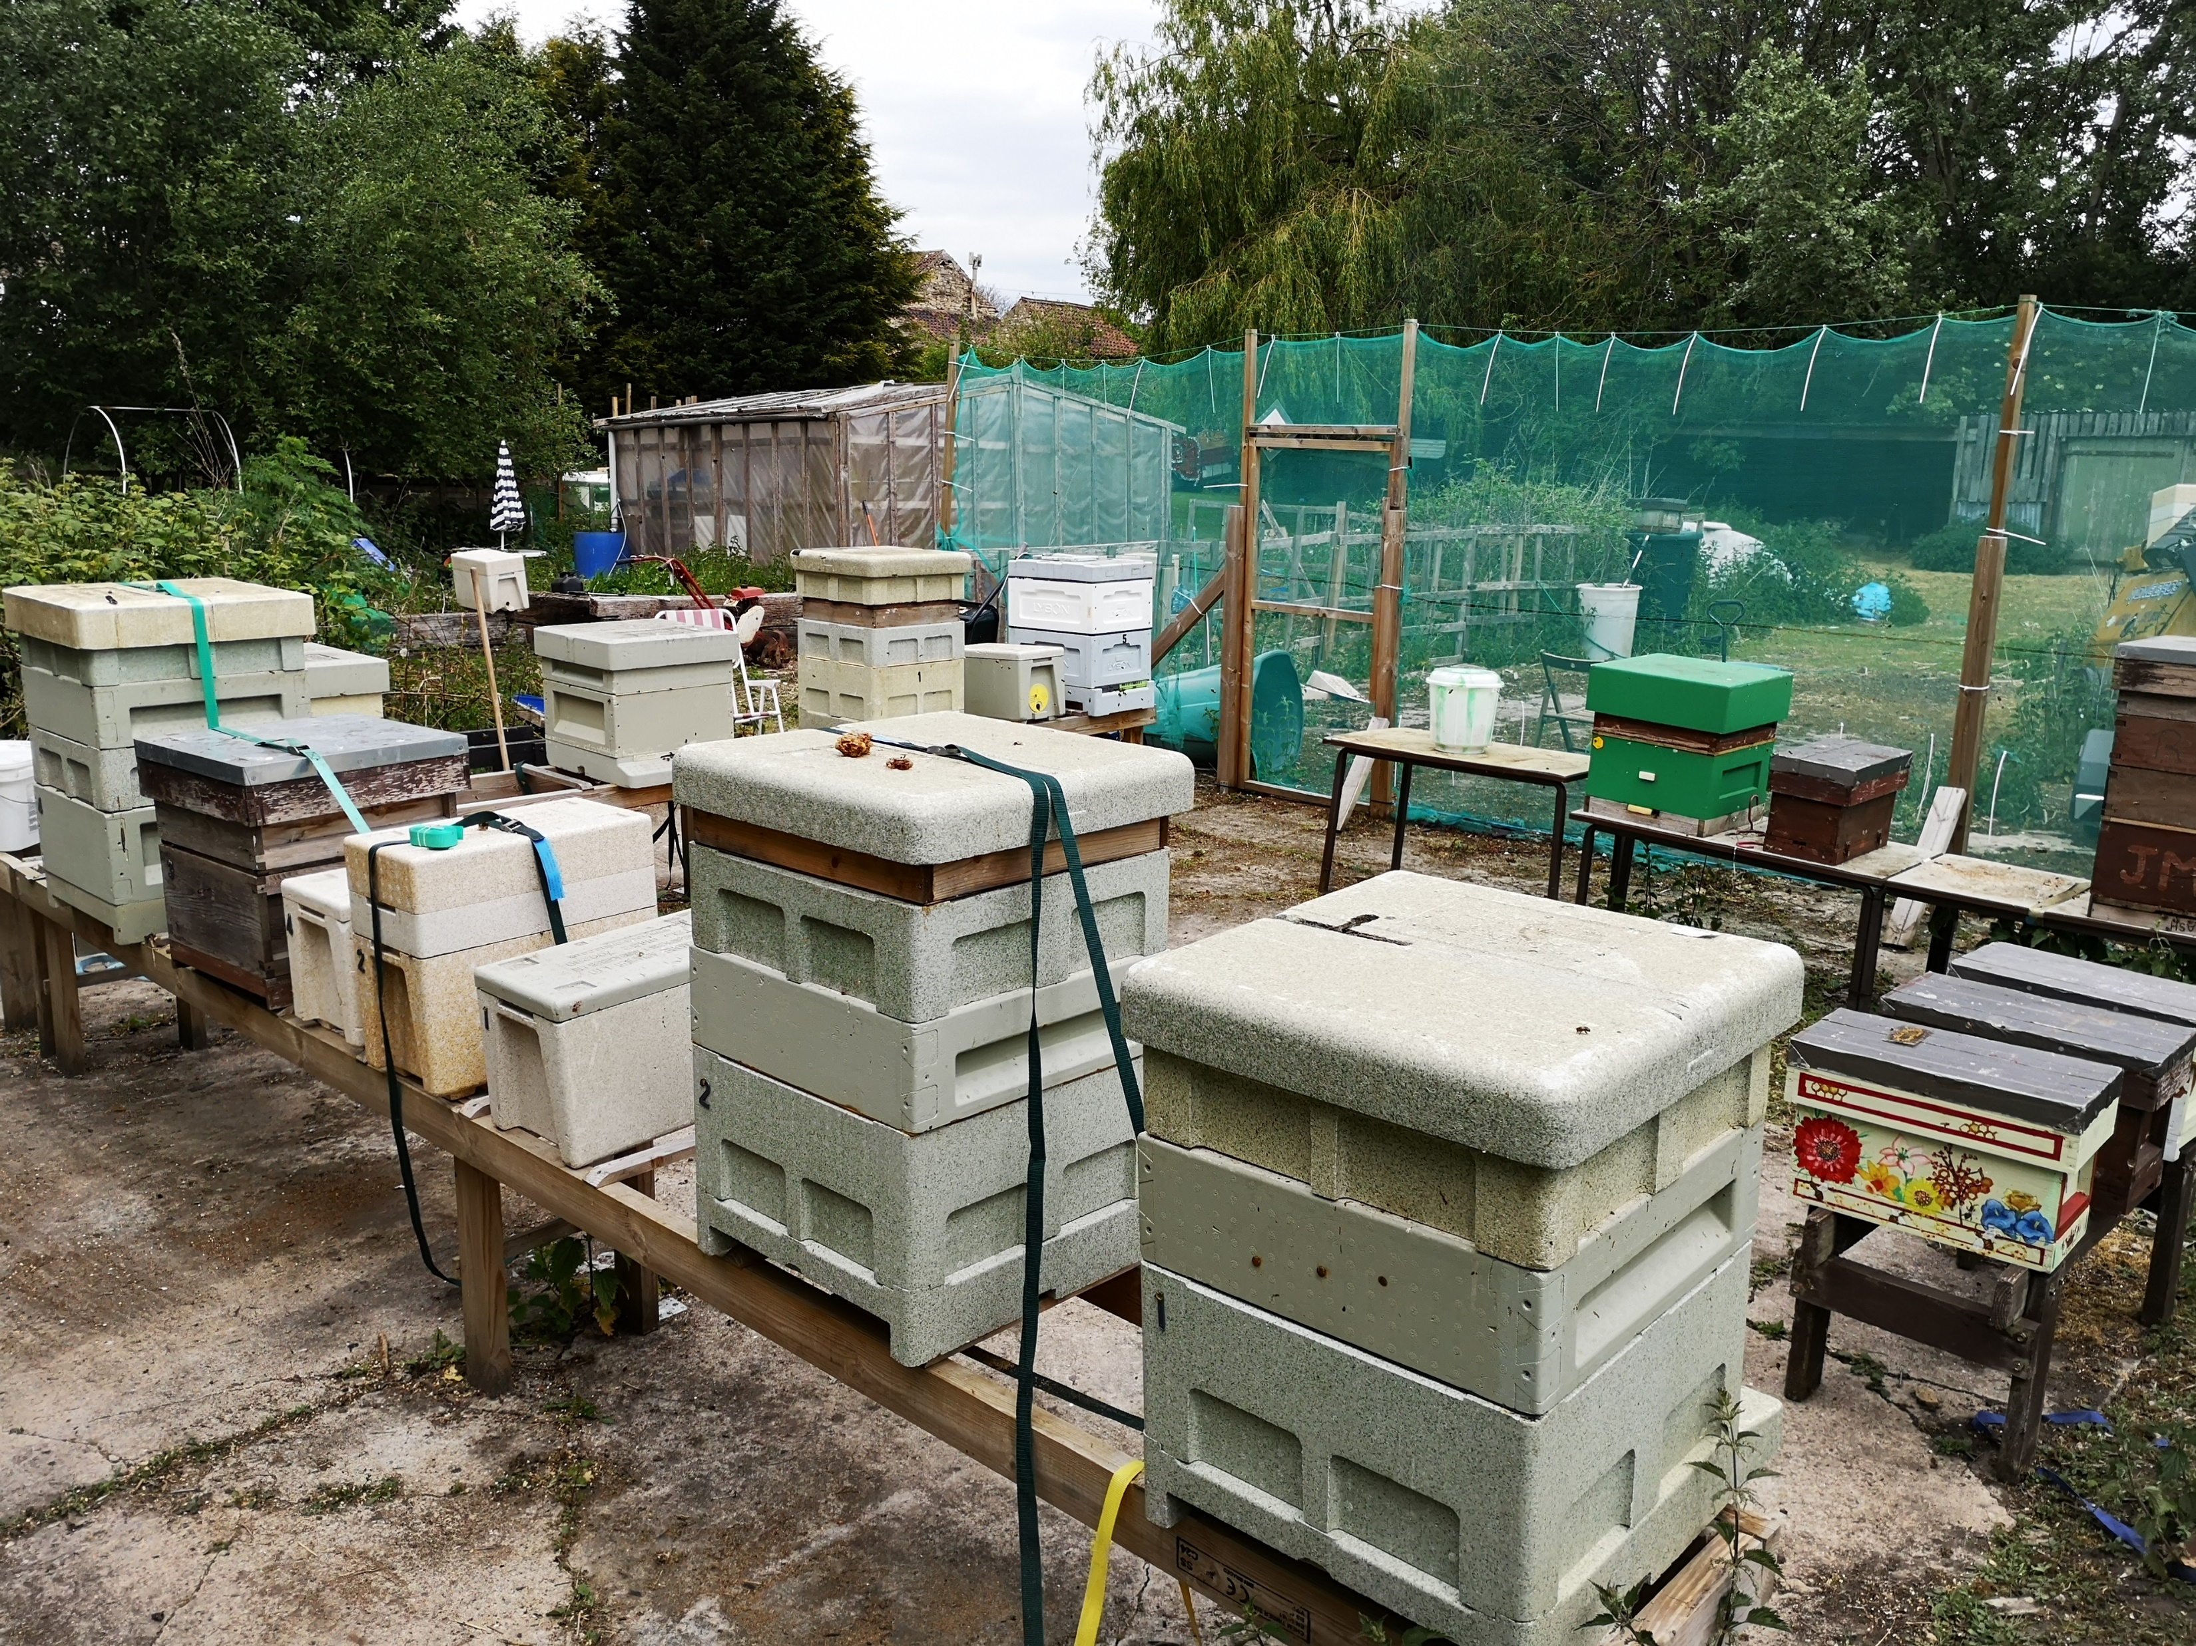
Your Apiary
What area have you got available?
Does it belong to you?
  Restrictions
  Longevity
How many colonies will you have now/future?
Access?
Ground conditions?
Consistent water supply
Notes:
These items are individual but you need to cover them so the information is available for the decision on placing an apiary can be made correctly

Slide 5
Your Apiary
Do
Position hives where they can get some sun
Ensure that they are positioned to prevent drifting
Leave space for swarm control
Have spare hive stands
Have some surrounds that protect the hives
Consistent supply of water
Don’t
Put hives directly under trees
Crowd the colonies together
Position near public path
Position where your hives are obvious
Where access is difficult
Where you have no place to store kit
Where there is no water
Notes:
Try to give guidance on these items as they appear, and why they are important e.g. Drifting causes some hive to lose bees and others to gain, and can spread disease.

Slide 6
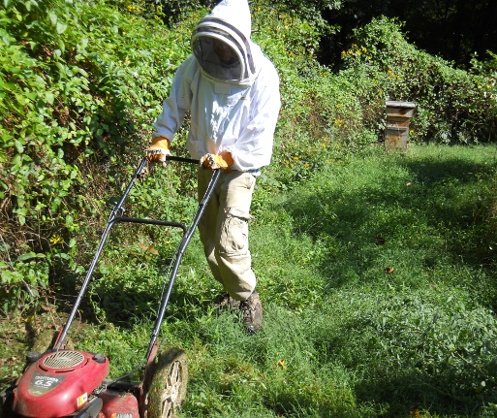
Apiary Maintenance
Hedges and fences will need occasional attention
  Position hives so that there is space between hive and obstruction
  Do the maintenance in the winter
Bees are very sensitive to vibration
  Mowing and strimming will cause a reaction
Hive stands last longer on slabs or on ground cover
Notes:
Try to give guidance on these items as they appear, and why they are important , never strim in an apiary without your veil on unless you like being stung.

Slide 7
Garden apiary?
Positives
Easy access to the bees
Kit in shed or garage
Your private land
Likely to be secure
Water source under your control
Negatives
Pets
Children
Partner?
Neighbours?
Neighbours ponds
Neighbours washing and vehicles
Notes:
Any guidance you can give of mitigations e.g. windnetting fences etc is good

Slide 8
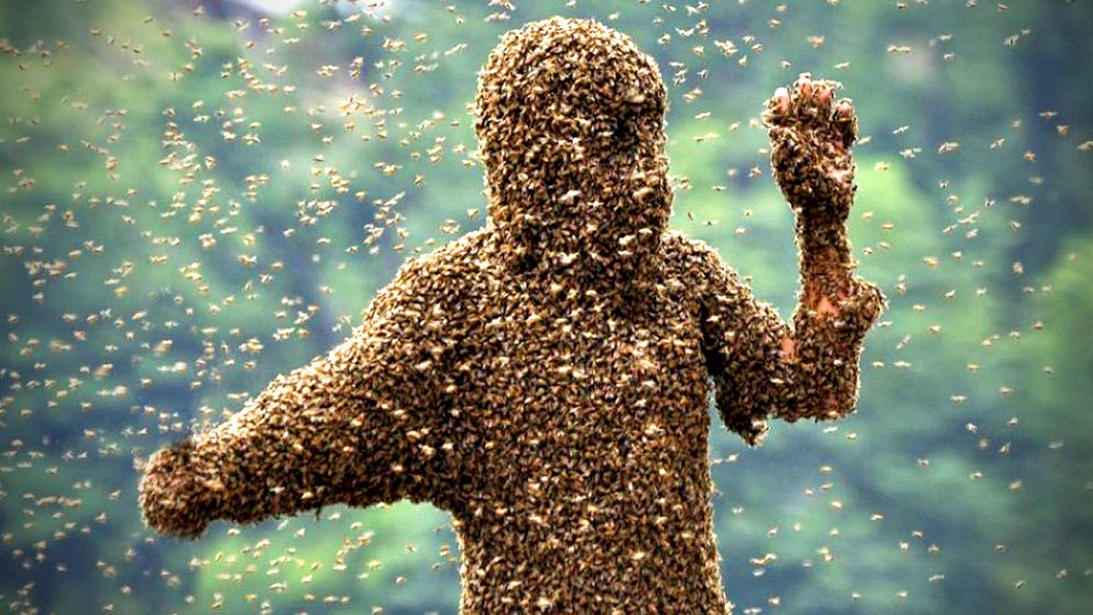
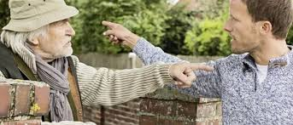
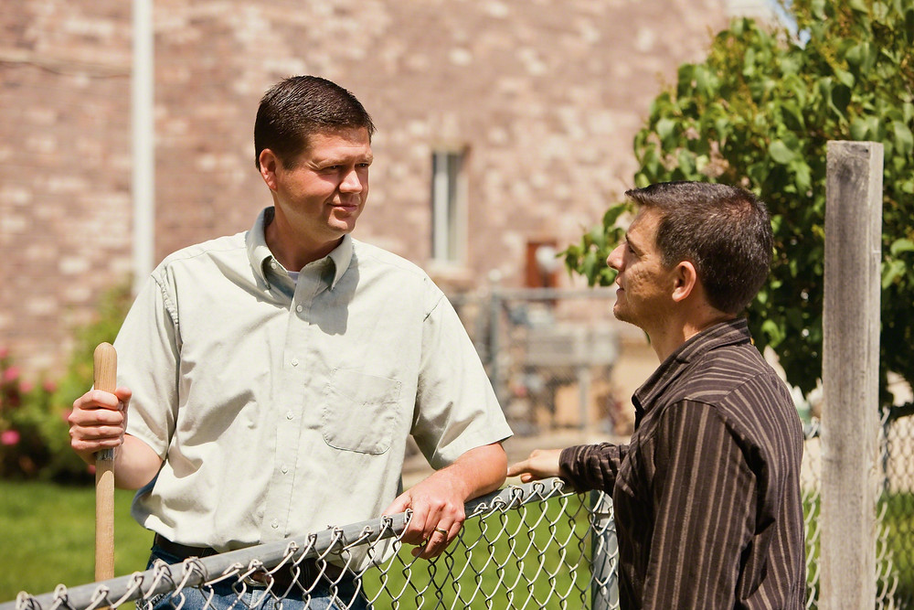
Neighbours
Many people are irrationally afraid of bees
A reasonable garden can accommodate 2-3 hives
  1 to 2m between hives
Bad tempered bees need to be removed, they will become a nuisance (3 miles away)
Place hives so the bees leave the garden at height
  Face hive toward a good hedge/fence, wind netting
  Obstruction should be at least 6ft preferable 8ft high
Swarm control imperative!
Jars of honey always help
Notes:
Note that keeping neighbours happy is needed. The law is likely to side with them not you unless you have taken suitable precautions. Nasty bees are not more productive and need to be re-queened or moved away from people ASAP.
Does the association have anywhere to move bees to in an emergency.

Slide 9
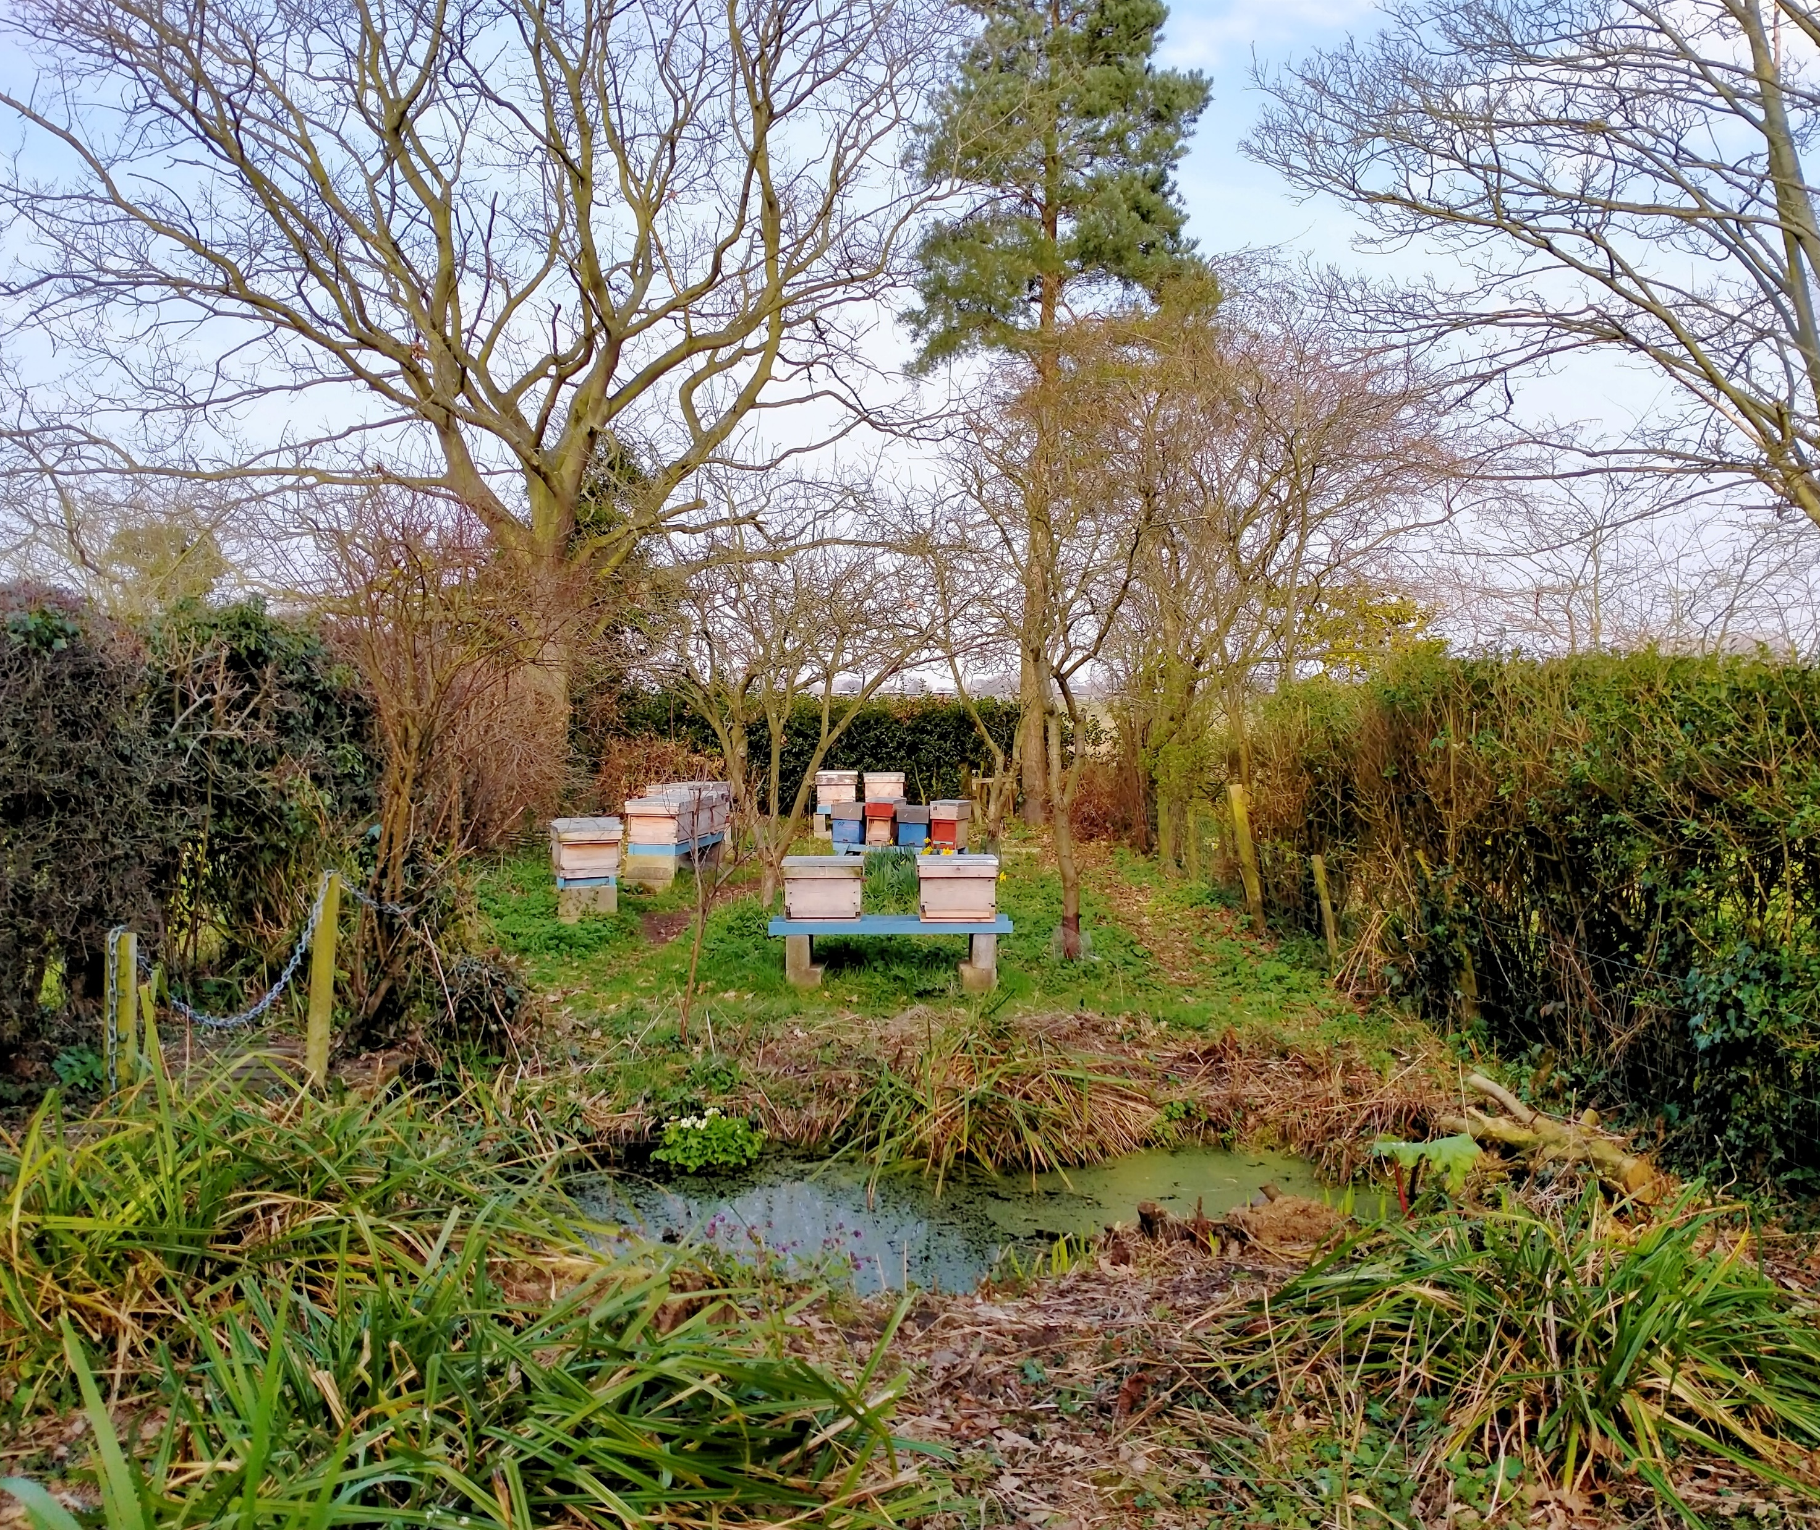
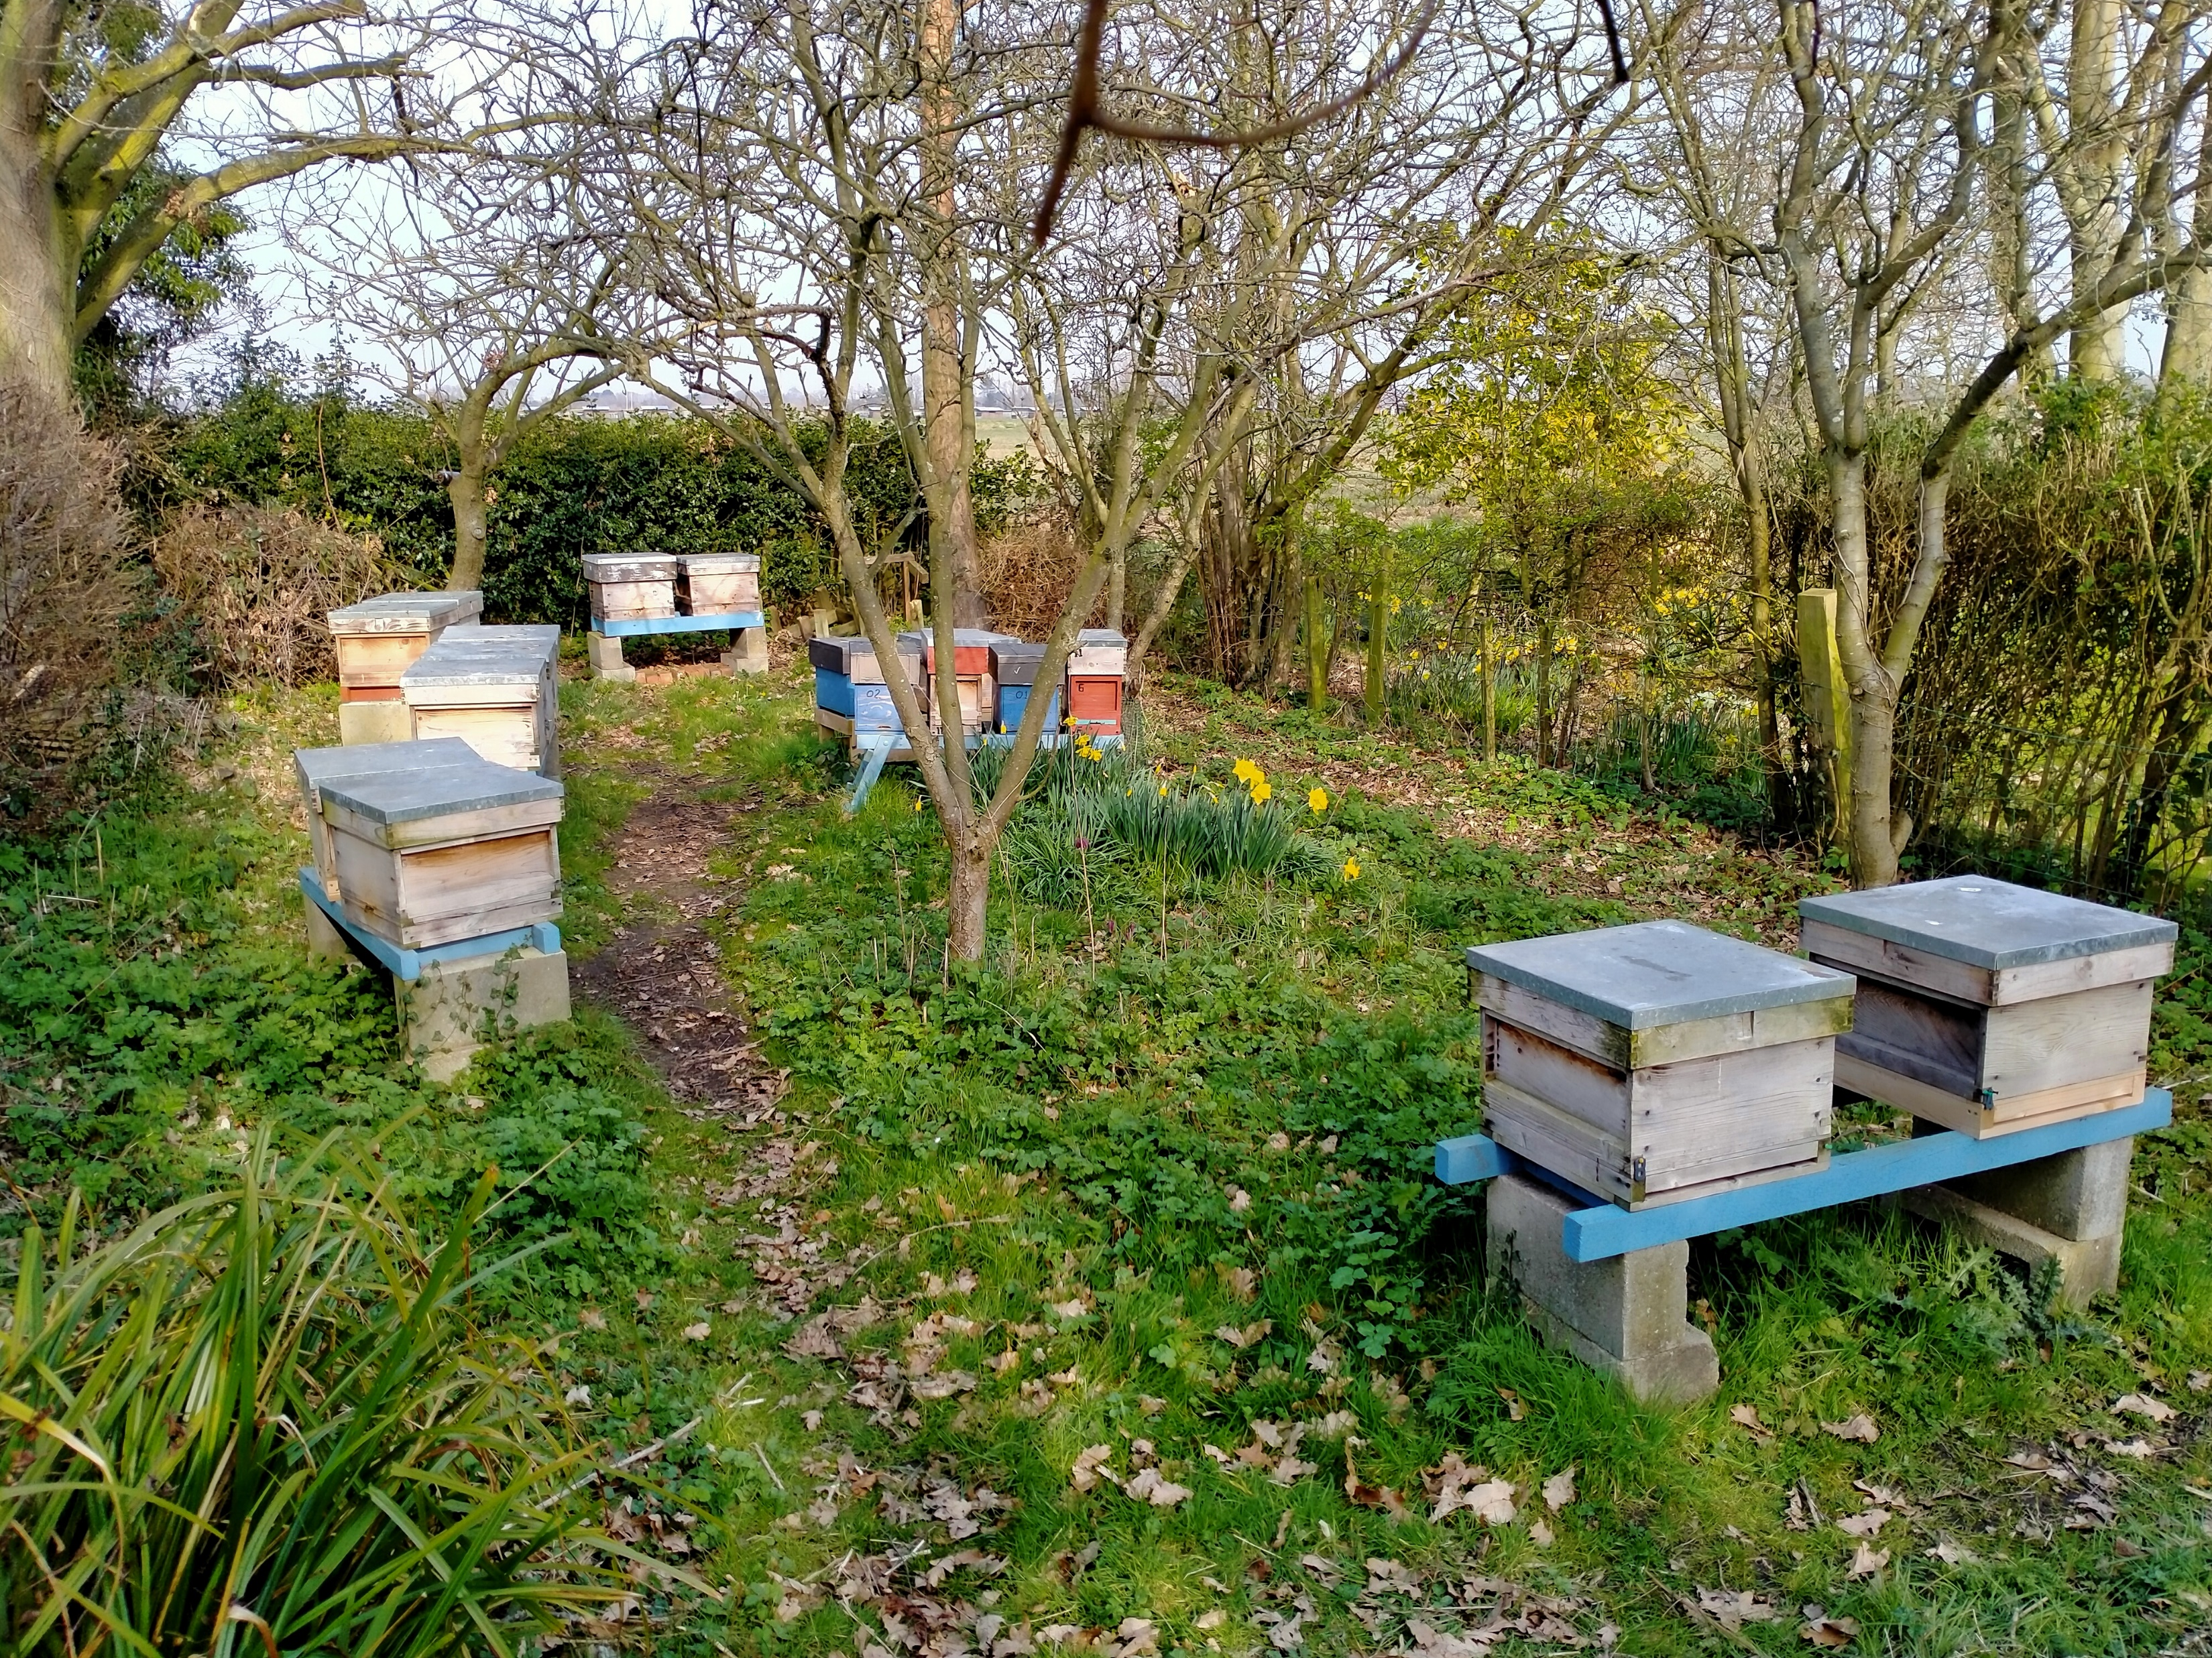
A home apiary

Slide 10
Out Apiaries

Slide 11
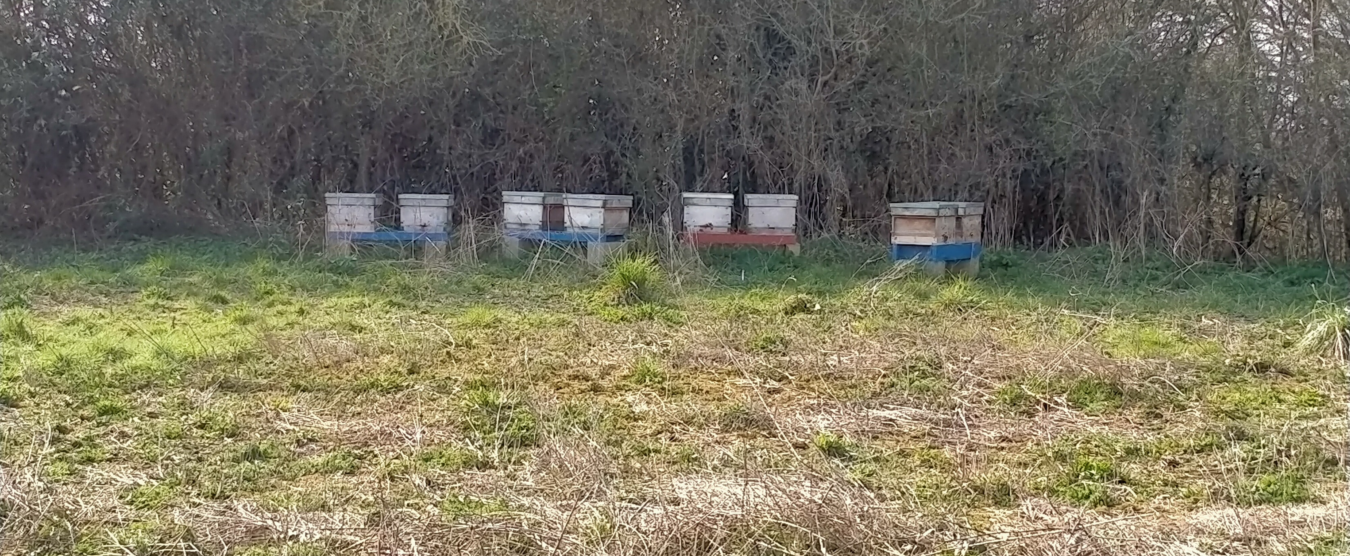
A Out Apiary

Slide 12
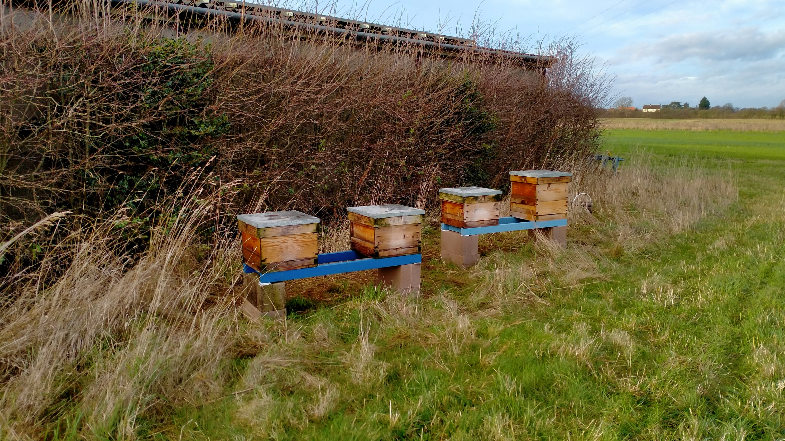
Out apiary

Slide 13
The years work
Inspections and how

Slide 14
How often?
Frequency of inspection depends on
  Time of year
  Weather
  State of the colony
    Is it in need of help?
    Is it giving indications of swarm preparation?
Notes:
Weather is a critical factor, type of inspection can be from looking to see if they are still there and hefting for stores to full disease inspection.

Slide 15
General Guidance
Winter, once bees are not flying
  2 to 4 weeks to check food and ensure hive secure
  Not opening brood box
Spring
  Every 2 weeks for stores level and brood build up
  Not opening brood box

Slide 16
General Guidance
Late spring thru to early Autumn
  Weekly internal inspection once weather is reliably above 15C (or if bees are flying in numbers)
  Once you see Drones you are on notice that swarming can occur!
  From egg to sealed Q cell 8 days!
  Looking for colony build-up, stores building, signs of swarming
Autumn
  Weekly until drones disappear or weather deteriorates
  Ensuring they have stores for winter or feed them
  Once they cluster, revert to winter schedule
Notes:
Drones are needed for swarming they take about 6 weeks from egg to sexually mature drone.
Drone production means that the colony believes that it has enough resources to multiply.

Slide 17
HOOPER’S Guidance on inspection
Has the colony sufficient room? (Nectar/Honey, Brood)
Is the Queen present and laying at the expected rate?
Is the colony building up as expected/are there any queen cells present in the colony?
Are there any signs of disease or abnormality?
Has the colony sufficient stores to last until the next inspection?
Notes:
This will mean more when you get into the practical sessions, if you answer all of these questions you will have carried out a good inspection and you will start to understand your colony.
Sheet for laminated card reminders.

Slide 18
When does it start
The more active the bees the more the beekeeper is involved
Do not disturb the bees when they are clustered
  Oxalic based Varroa treatment when there is no/minimal brood (Dec/Jan)
When the bees start flying on warm days
  Check stores – weight of hives
  Add fondant to supplement
When they start collecting pollen
  Brood raising is starting to increase
  Remove mouse guards- they strip pollen from bees pollen baskets

Slide 19
First inspection?
When - It depends
  Has the weather been consistently good for a few days
  What is the forecast
  No inspection below 10C preferably 15C
What is your purpose
  What information can you gather before you open the hive
    Pollen going in
    Dead bees being brought out
    Hive still heavy?
If you have been feeding fondant how much is left above Crown board

Slide 20
Inspection Technique-Preparation
Get all the equipment ready
  PPE, Smoker, hive tools etc. clear the area
  Light smoker and ensure it is well lit with sufficient fuel
Gather information before opening hive
  Inspection records, bees activity etc
Suit on
  Veil in place
  Zips all done up
  Gloves on and cuffs held down
Know what you are looking for (Ted Hoopers 5 questions)
Notes:
Especially in marginal conditions the brood box disturbance should be minimal and the period that the box is open should be a short as possible. Be prepared and have a plan in your head on what information you want.

Slide 21
Inspection Technique- In the hive
Systematically and carefully open the hive and inspect it
  Smoke as needed but apply gently
  Remove roof & crown-board
  Supers if any
Inspect Brood box
  Where are the bees how, many seams are there?
  If removing Q excluder check the underside for the Queen
  Any empty and poor comb you can take out/replace?
  Have you seen Q or eggs?
  How many frames of brood/stores
  Laying pattern of Q?
Notes:
This will take more time initially, but will become quicker as you become used to the system. This is the basis of the practical sessions

Slide 22
Inspection Technique- Finishing
Hive rebuild
  Close the frames together gently make sure tight together ( respect the bee space)
  Replace dummy board
  Replace Q ex and super(s)
  Super(s) heavy/light/populated
  Replace crown board
  Replace roof
Wash Hands and tools
Write up hive record
Crushing bees releases
alarm pheromone, increases the chance of spreading disease.
Notes:
Rebuild the hive carefully, use smoke as required and avoid crushing bees.
Record everything properly you will NOT remember next time

Slide 23
Recording the Inspection

Slide 24
Beebase & Hivelog
Notes:
Attempt to show a live entry
This may well fail!!!!
If the IT signal is good this will be a good demo otherwise it is too painful to do

Slide 25
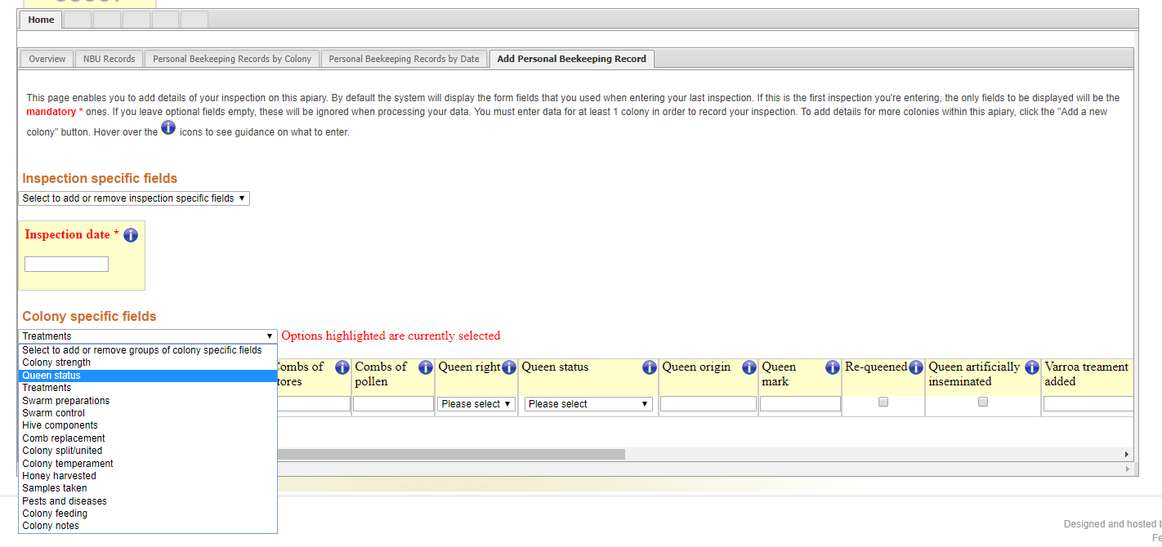
NBU Beebase Records
Notes:
This is done online but you had better take notes in the apiary. Tablets etc do not react well to honey/wax/propolis and dunking in the wash bucket.

Slide 26
Paper and Pencil

Slide 27
Notes:
This is an example of a sheet with its key there are many available

Slide 28
Notes:
Using this inspection record explain what a seam of bees is and how you can use it to gauge the progress of the hive. The notes are for unusual actions and to help predict when actions will need to be taken.

Slide 29
Equipment

Slide 30
Equipment-Beekeeper
What do you need
  PPE
    Wellies/Boots
    Veil/jacket/suit
    Gloves ( to protect the Bees!)
  Hive tool
  Wash bucket
  Queen box?
  Smoker & stuff to light it
  Record sheet and pen
  Trug/box to carry things in
Notes:
Self explanatory except that this gives the tutor a platform to answer questions on when do I need to buy it, where from etc
Useful to have example kit available to show.

Slide 31
Equipment- Bees
Hive
  Stand?
  Floor
  Brood box
  Supers
  Queen excluder
  Crown board
  Roof
In the hive
  Frames and foundation
Feeder
  Contact
  Rapid
  Eke
Notes:
It is good to have real equipment to discuss at this point and this section can be done with tea in hand around the equipment with students handling it.

Slide 32
What you need
Before the apiary practical you will need
  Suit
  Gloves (washing up ones or nitrile type)
  Wellies or boots
  Cuffs if you want them
Notes:
Best practice for hygiene and disease control is to provide smokers, hive tools etc for use in association apiaries.
Base instructions on what your association does.
Do you have loan suits available or do students need to buy their own immediately.

Slide 33
For your bees- if you get some
You can obtain bees in various ways and at a variety of costs, swarms, nucleus, full colony. Each requires a different approach to getting them going.
You will need various amounts of kit depending on the way you have elected to obtain your bees
You might need extra frames with foundation
You may need a super with frames (or more) if the season is good
You will need a super and feeder if the season is bad
Notes:
Explain how you need a super to enclose the feeder, use of real equipment is helpful here

Slide 34
Other useful things
Duct tape or sponge to seal hive when you move it
Straps to hold hive together while moving
Tray or heavy plastic to protect your car
Bricks to hold the roof down when in your apiary
Trug/tool carrier to hold all the bits
Notes:
Opportunity to encourage members to seek help when moving bees

Slide 35
Getting the equipment
Thornes
Claro Bees (RHS Harlow Carr, Harrogate SAT A.M. only)
Abelo (A1079 to Hull, Dunnington, York)
Maisemore
Bee Equipment
Plus many more
Association has a 12% discount arranged with Abelo on internet purchases (discount code required, click and collect very good)
Compare prices with delivery and quality before you choose

Slide 36
Reminder--Books for beginners
BBKA Guide to Beekeeping 2nd ed
BBKA Healthy Hive guide
Haynes Bee Manual *****
Practical Beekeeping – Clive De Bruyn
Guide to Bees and Honey- Ted Hooper ****
The Complete Guide to Beekeeping – Jeremy Evans
Teach Yourself Beekeeping – Adrian & Clare Waring
BBKA special editions
BBKA News –monthly - free for all BBKA members
BeeCraft Beekeeping Magazine – monthly subscription
Plenty of beekeeping books available from Northern bee books
Notes:
36
Explain how to access back copies of BBKA News.
These are books you can consider using to help you. You do NOT need all of them, some of them are easier to use than others.
Northern Bee Books stocks all of these
Helpful if examples of the books are available to view

Slide 37
Next Time
Revision
  Please make a note of any thing you think of during the week that you would like clarified/revised
  There are no stupid questions
  There may be some dodgy answers!
Introduction to honey and hive products
How to access Association loan equipment
Location of practical sessions
Future progression in beekeeping expertise

